Slide 1




BUG BUSTERS

Slide 2
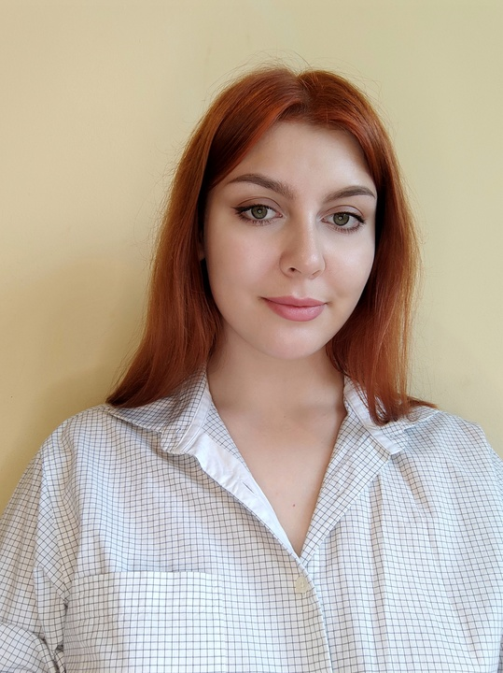




УЧАСНИКИ КОМАНДИ
Сафонова Катерина
Team Lead
Корж Анастасія
Scrum Master
Пахомов Денис
QA Engineer
Гелла Тетяна QA Engineer
Дрогобицька Тетяна QA Engineer

Slide 3



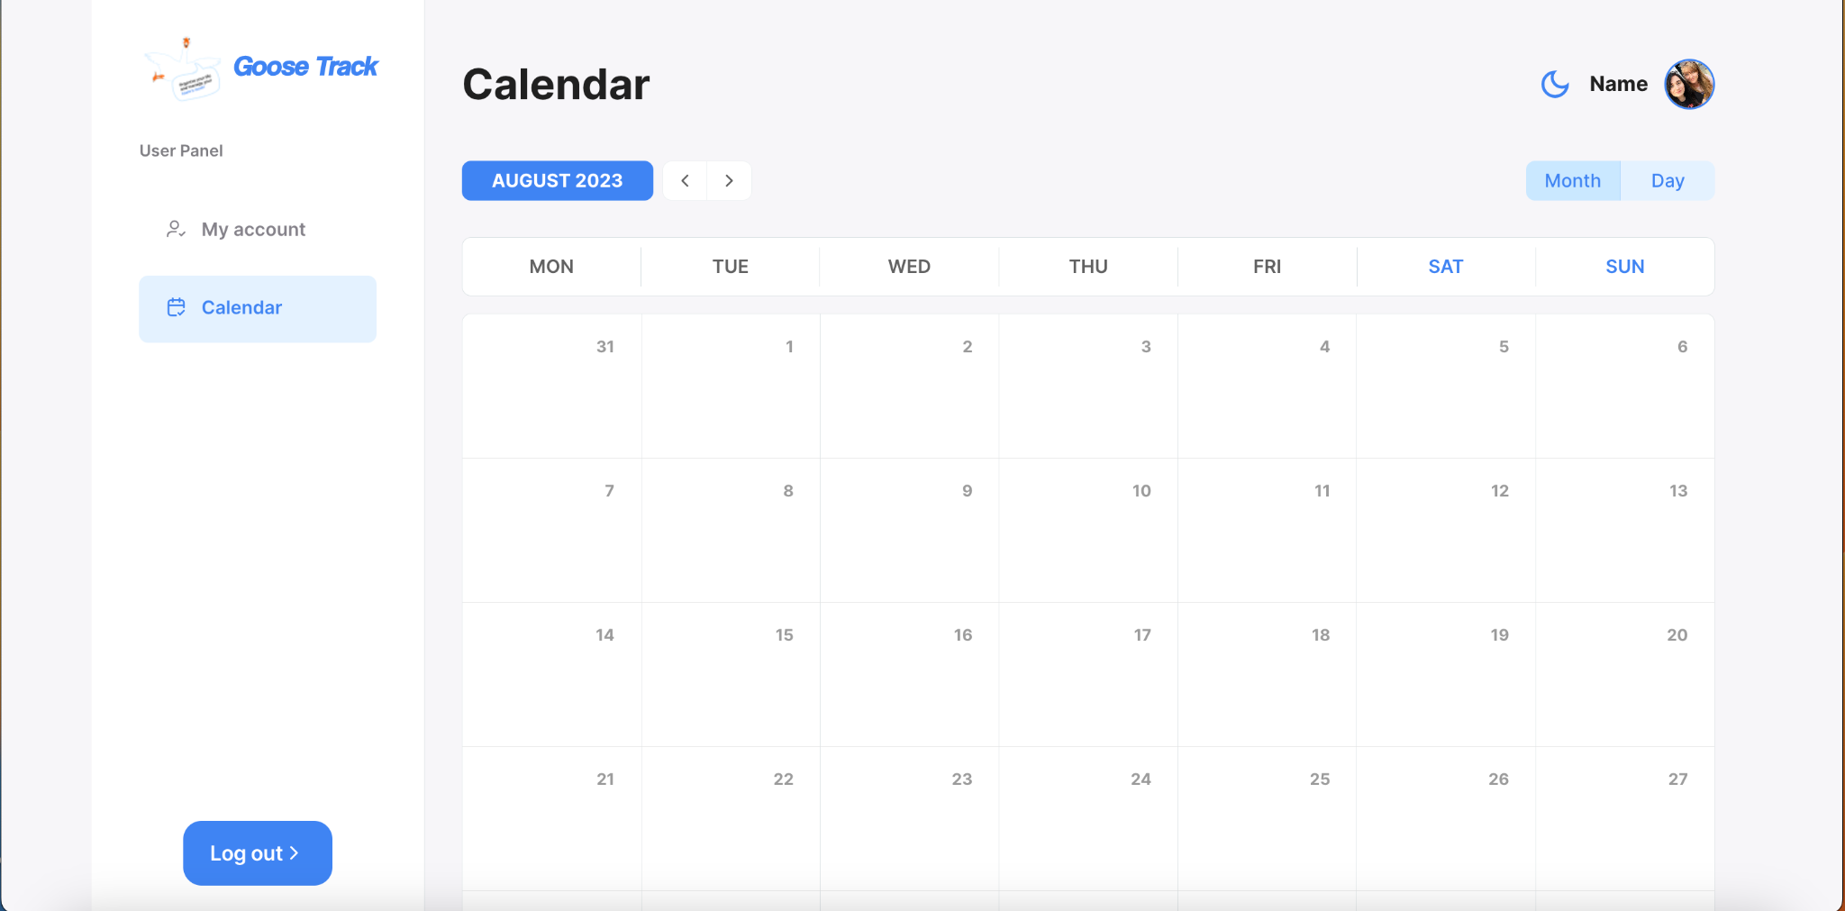



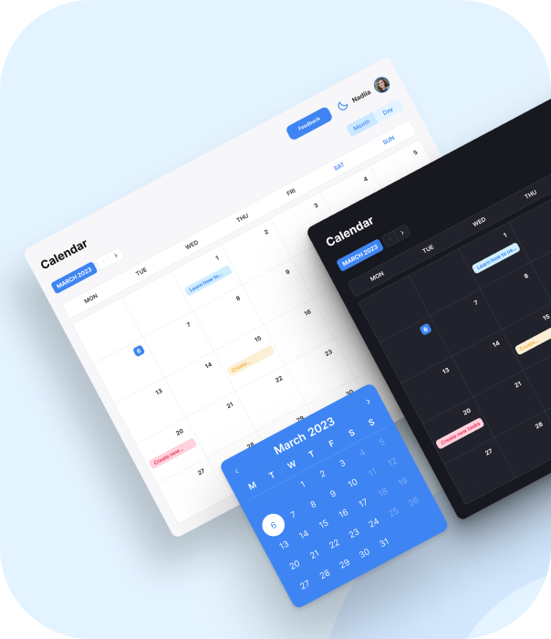
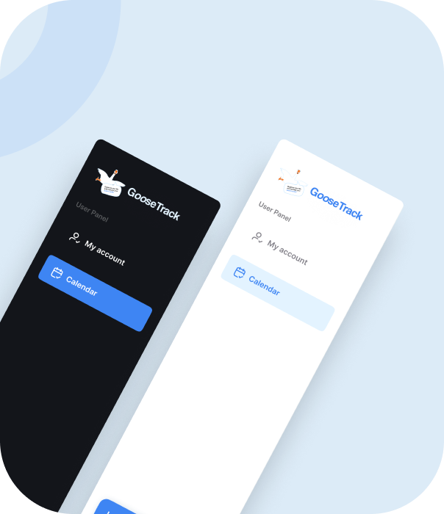

Slide 4
Test levels
System Testing
Acceptance testing
Testing types
Usability testing
Functional testing
Non-functional testing
Compatibility testing
User Interface testing
Portability
Black box testing test design techniques
Equivalence partitioning
Boundary value analysis
Decision table testing
Tools
Trello
DevTools
Swagger
Android Studio
Google Sheets
API Testing
Review

Slide 5
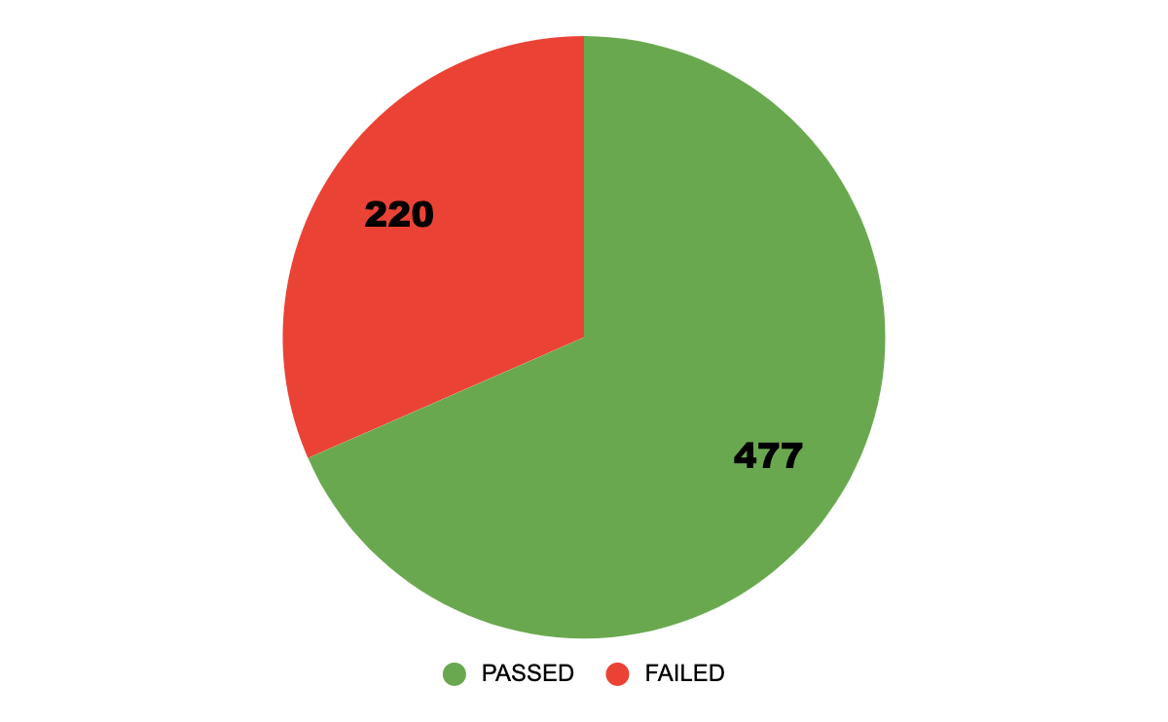

Total 697

Slide 6

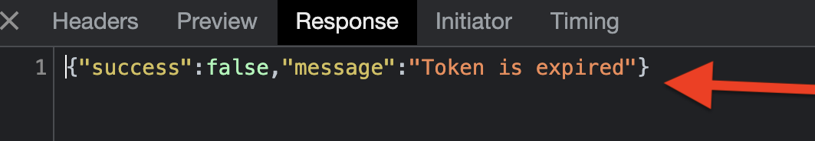
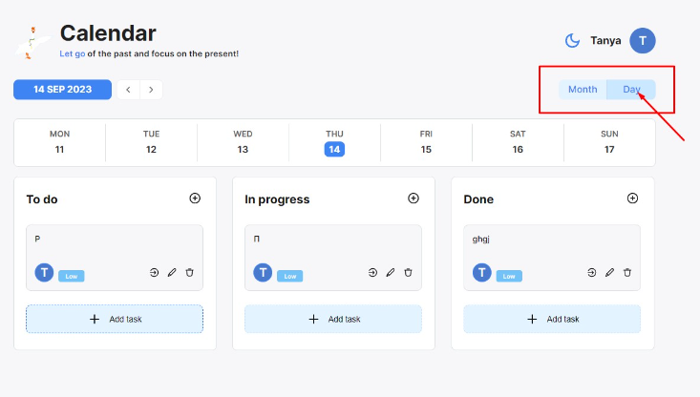
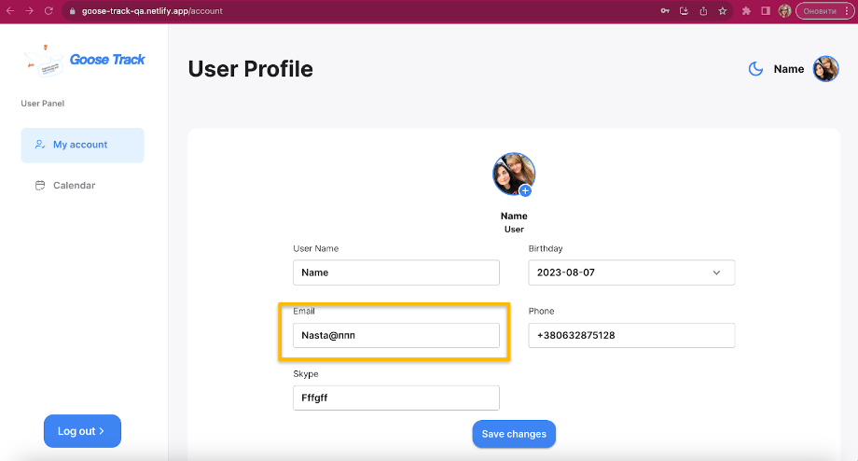
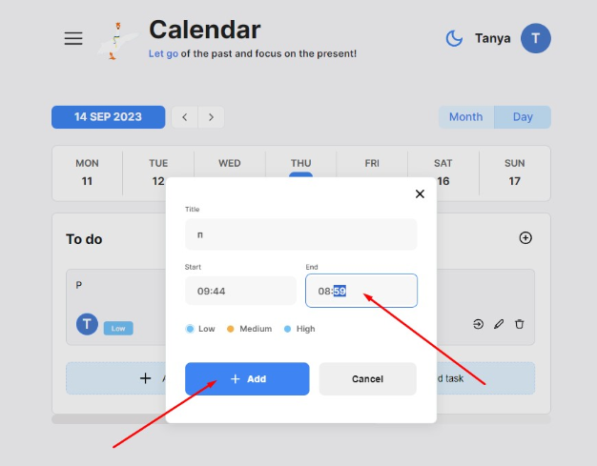
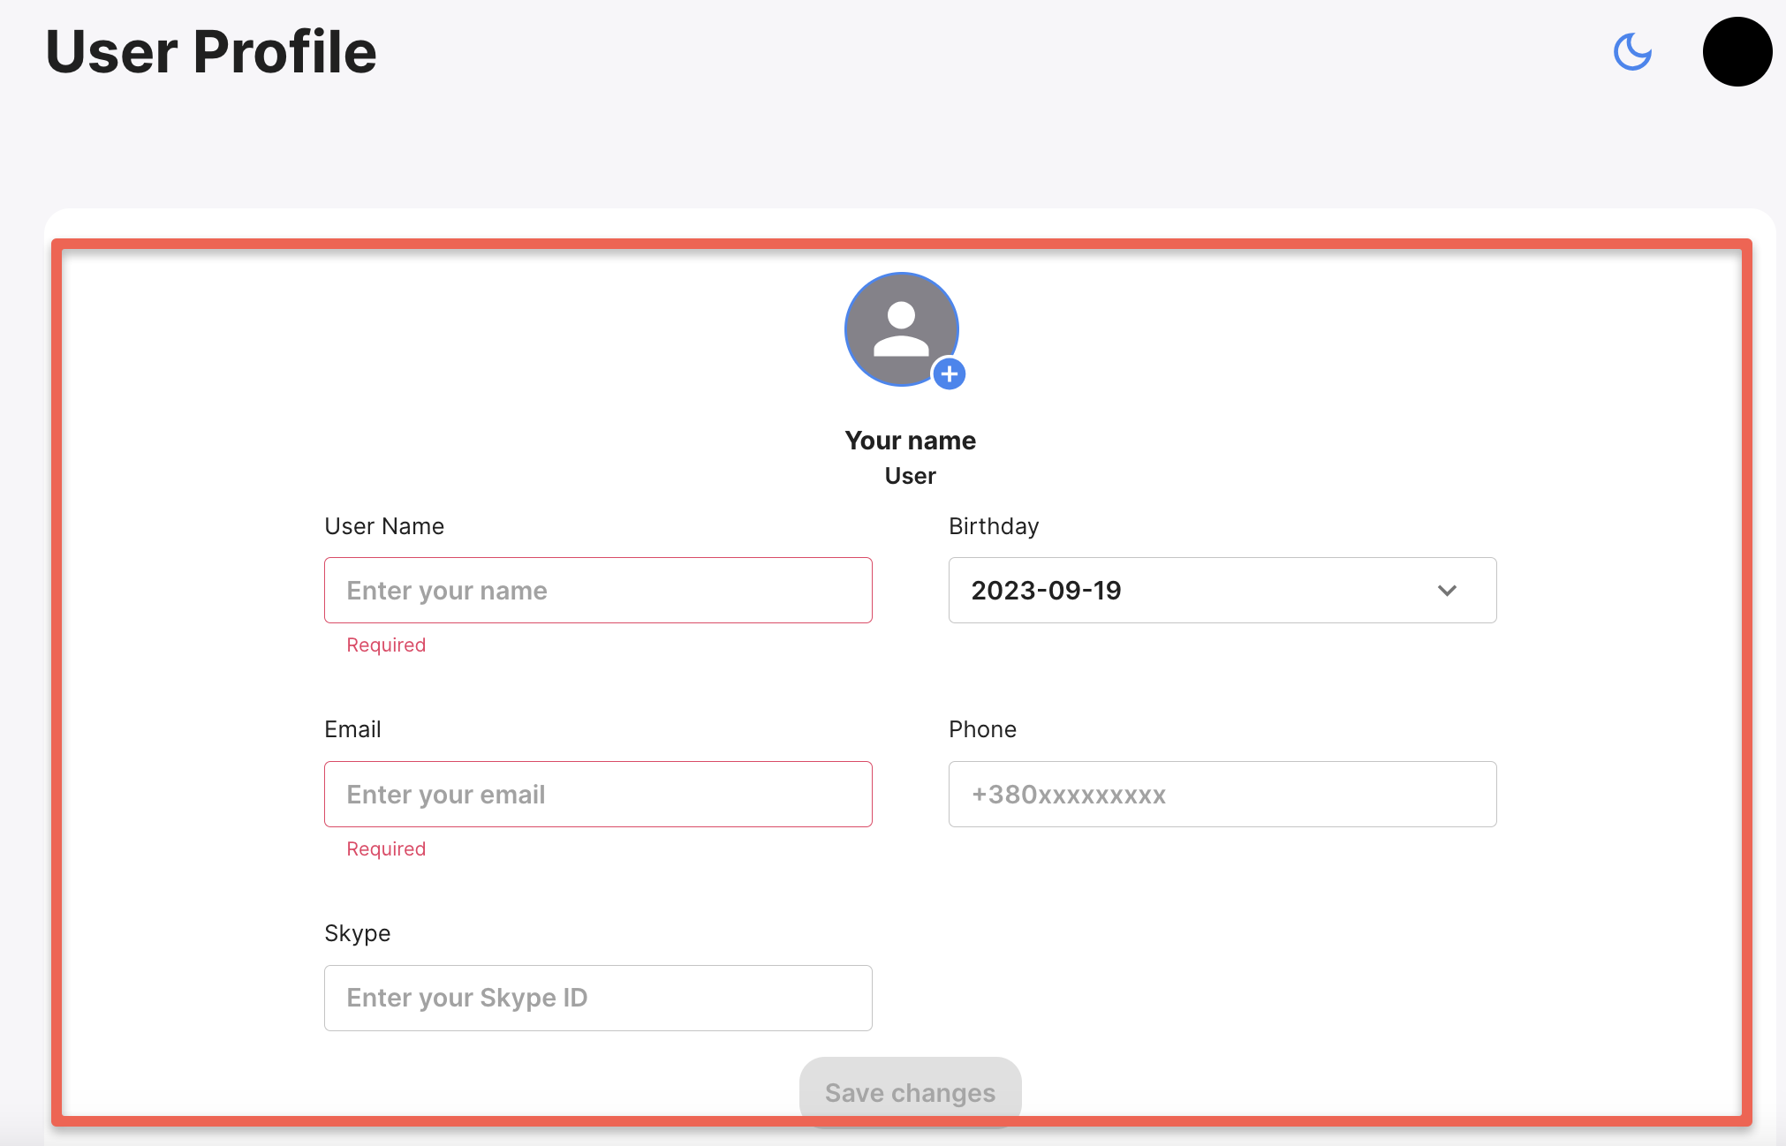
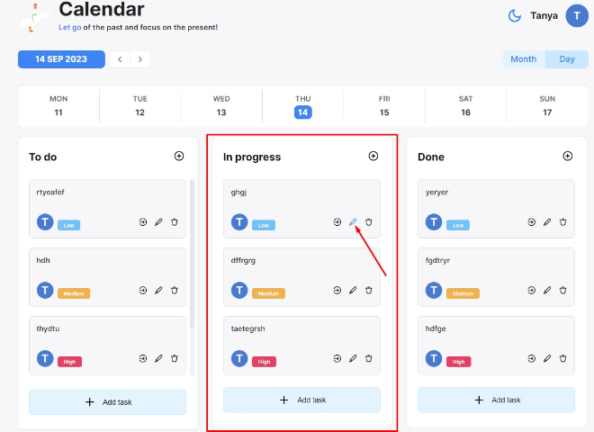
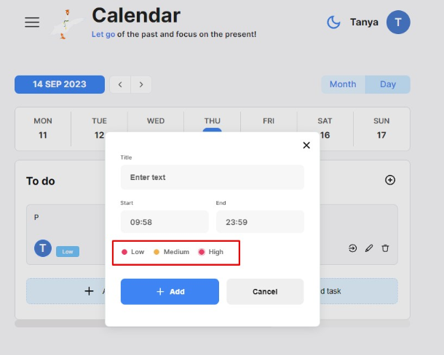
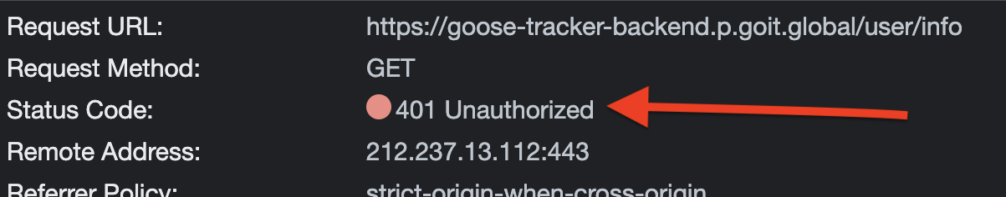
Short Token Lifetime Without Auto-Refresh Functionality

Slide 7
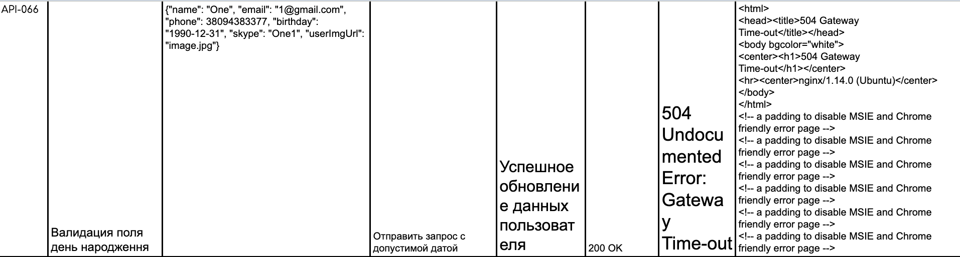
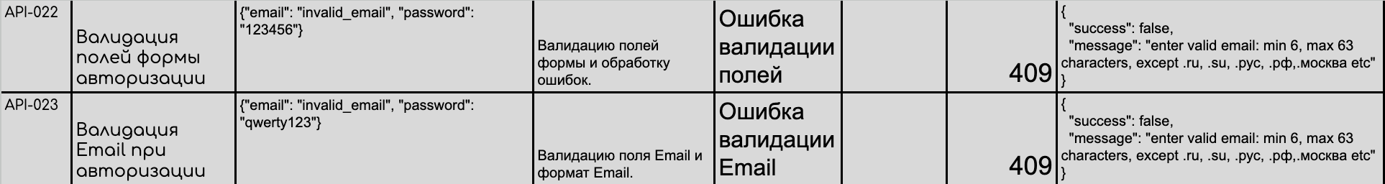
API TESTING
NO RELEASE

Slide 8

Дякуємо за увагу!

